Slide 1

The capstone project

Slide 2

Otp verification system in python

Slide 3

Python
Guido van Rossum from Netherlands ,
created Python programming language and released in 1991
Aiming for readable ,
high-level programming language

Slide 4

Tools used :
The google colab – Integrated Development Environment (IDE)
Served as a primary tool for the development of this project – OTP verification

Slide 5
PROJECT REQUIREMENTS :
Implement a function to generate a 6 digit OTP randomly.
Develop a function to stimulate sending OTP to the user email address.
Create a function to prompt the user to enter the OTP received in their mail.
Implement a function to verify if the entered OTP matches the generated OTP.
Ensure proper error handling and user - friendly prompts throughout the system.
Allow the user to retry OTP entry in case of incorrect output.

Slide 6
What is OTP?
ONE TIME PASSWORDS are time sensitive codes used for user authentication.
OTP bolster security by adding an extra layer of verification, making it challenging for unauthorized individuals to access accounts or systems

Slide 7


Modules imported :
Importing SMTP library.
Importing ‘Random’ module.

Slide 8
Smtp library
Simple Mail Transfer Protocol (SMTP) used for sending email messages between servers.
Python provides SMTP library that simplifies the process of sending emails programmatically

Slide 9
IMPLEMENTATION STEPS FOR OTP GENERATION AND EMAIL VERIFICATION:
Creating a user defined function to generate OTP using a module called ‘random’
Build a function to set up a SMTP (Simple Mail Transfer Protocol) server and mail credentials for sending emails.
Developing a user defined function to validate the received OTP.
Creating a function to type the Email address as a input for receiving the emails.

Slide 10
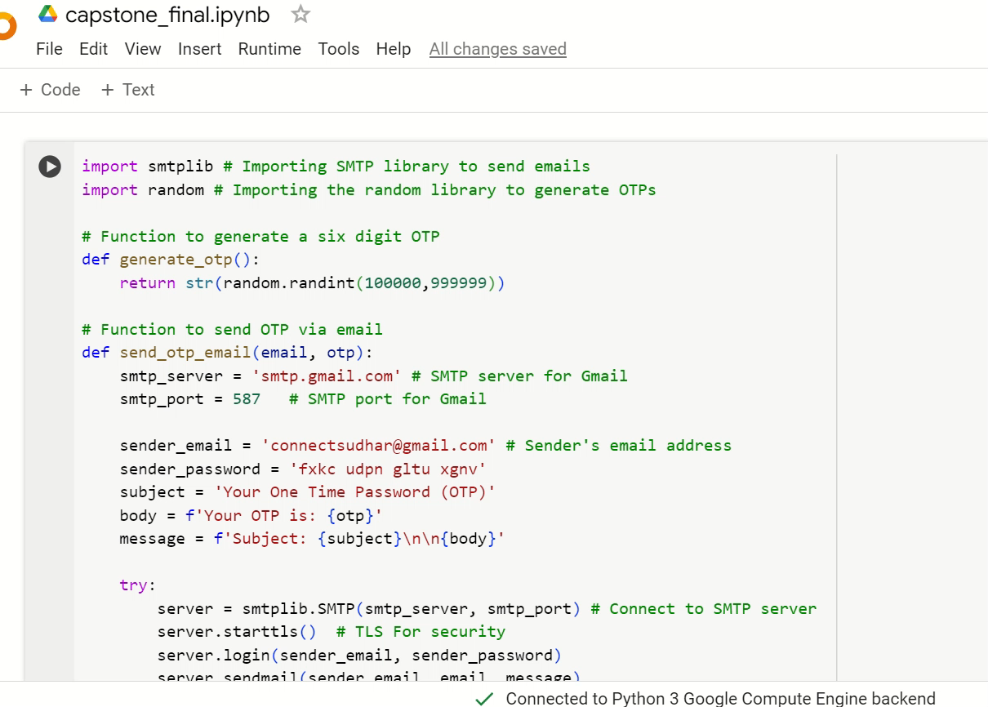
A Footage from colab ide:

Slide 11


